Slide 1
BROKERING
THROUGH
THE COVID-19
PANDEMIC:
Working through PPP loan concerns and utilizing creative financing to close more deals!
August 2020

Slide 2
About your presenter
Steve Mariani has focused solely on acquisition lending, personally closing over $1 billion in SBA transactions since establishing Diamond Financial Services in 1996, almost 25 years ago. Specializing in larger, goodwill, transactions and utilizing the most aggressive national lenders, Diamond Financial has become the largest privately owned SBA loan provider in the nation. Self-employed since 1983, Steve is uniquely qualified to represented the small businesses of the United States.
!
First things first.
Single most important thing, stay safe and know we are here for you.
I am your IBBA board affiliate counsel chair and YOUR chapter’s direct connection to the IBBA

Slide 3
What effect do PPP loans have on the
current broker acquisition market?
Buyer’s lender MUST determine if the seller has a PPP loan in place as this DOES effect the closing.
Transactions can close with a PPP in place if approved by SBA, but none have as of today.
What you need to request today and understand from your seller that has a PPP loan
Diamond Financial Services, Inc. Copyright 2020

Slide 4
PPP loan notes “typically” include events of default!
any person or entity, or any group of related persons or entities, shall, without Bank’s prior written consent, have or obtain legal or beneficial ownership of a majority of the outstanding voting securities or rights of any Obligor that is not a natural person, other than any person or entity, or any group of related persons or entities that has such majority ownership as of the date of this Note; or any change in the ownership or control information in Borrower’s Beneficial Ownership Certification shall have occurred since the date of this Note;
Stock Sale or Asset Sale
What you need to request and understand from your seller
Diamond Financial Services, Inc. Copyright 2020
Notes:
A transfer instantly triggers an event of default
Buyer remains exposed

Slide 5
PPP loans can be in place during an acquisition, just do the following.
From the SBA:
I can provide you with the most current guidance we have received regarding the change of an ownership of a business who has received benefit of PPP financing
As a Delegated Lender under the PPP program, a Lender would follow the SOP 50 10 5 ( K) 327 Matrix and in particular the Footnote Item no. 17, which has been attached for your reference, when the principals / ownership of the borrowing entity is changing. NOTE: SBA does not review documentation relied upon to be read and approved by a Delegated Lender.
Keep in mind the PPP loan's proceeds were not funded as part of a project to finance a change of ownership. They were specifically issued for the benefit of the borrowing business entity's payroll and other operating expenses, etc., as originally reported in Etran.
A PPP borrower may sell their business during the period when the PPP loan is outstanding and before forgiveness has been granted. In such a scenario, the seller and buyer must work with the lender (or the Lender that is servicing the PPP loan) to have the buyer assume the PPP loan and continue to use any remaining PPP loan proceeds for payroll costs and other eligible payments of mortgage interest, rent and/or utilities in accordance with PPP requirements. If the buyer applies for loan forgiveness, the buyer will be subject to all applicable reductions and any issues related to eligibility that would have applied to the seller, including the possibility that forgiveness will be denied in whole or in part. (Only the buyer will be able to apply for forgiveness in this scenario.)
If the business entity is now party to a stock/membership transfer agreement or stock/membership redemption agreement; whereby, the principal holders are selling their interest to either a new third party buyer(s) or the business entity will be redeeming a current holder(s) shares/interest, the PPP loan will always remain in the name of the original entity with the principals' ownership being updated in accordance with the Purchase/Redemption Agreement's provision, in Etran. The terms and obligations of the PPP guaranty and its requirements to be able to submit for forgiveness are highly recommended to be acknowledged in the Agreement, in order for the new principals to understand the PPP guaranty process.
In order to update Etran in accordance with the above guidelines, a Lender should be prepared to provide:
Confirmation that Lender has reviewed the Stock/Membership Purchase/ Redemption or Asset Purchase Agreement and determined the document has incorporated the specific requirements of the PPP Guaranty as originally issued, and has disclosed these requirements to both the Seller(s) and the Buyer(s). NOTE: 7aQuestions@sba.gov nor 7aloanmods@sba.gov does not review purchase agreements.
Confirmation that Lender has completed a third party validation for the new EIN#s belonging to the new entity owners and SSN#s belonging to 100% of the principals of the Borrower Entity, who is/are scheduled to be represented in ETran. A copy of the IRS EIN Assignment Letter is required to be provided as may be applicable.
Submit all necessary information needed for SBA to complete the Principal's screen(s) in ETran for each new principal. Confirm if the timing of the closing of the transaction would be occurring after the forgiveness period has passed for the PPP Loan.
Lender is reminded that they are responsible for the review of any /all documentation related to this action.
Once received and reviewed, SBA does not provide a forward commitment as may be related to any of the provisions of the PPP guaranty.
Please let us know if you have any further questions
Diamond Financial Services, Inc. Copyright 2020
Notes:
The buyer MUST assume all PPP liabilities whether the PPP covered period is complete or not.

Slide 6
What you can do today to help your seller
Understanding that 5,300 lenders were included in PPP loans and
in a typical year only 1,800 are active SBA lenders
Request a copy of your seller’s PPP loan note and understand the lender’s level of experience in SBA and their ability to assist.
Understand exactly when your seller can apply for forgiveness and be sure he is prepared to do so
2 Ways you can close your transaction today using SBA funds
Payoff the PPP loan in full prior to closing
Receive forgiveness prior to closing
Diamond Financial Services, Inc. Copyright 2020
Notes:
We don’t know how long forgiveness will take and I am monitoring a few different PPP lenders once August 10 passes.
2 ways to stay in compliance and close TODAY

Slide 7
Getting Creative with Financing
Four types of financing options for the short term:
Seller financing
SBA financing
Earn-outs
Forgivable seller notes
How creative should you get with each one?
Diamond Financial Services, Inc. Copyright 2020

Slide 8
Seller financing options today
Usually not the most cost-effective method
Very viable option today, mostly for smaller transactions under 1MM
Typically will demand a higher down payment– Maybe not in 2020
Typical terms are 5 or 7 years in most seller notes
The seller is able to remain in a UCC first position on the business and assets and can remain employed
CANNOT refinance this seller note with SBA for a minimum of 24 months
SBA rule states there MUST be 24 consecutive, non-late payments before eligible
Can include earn outs
Earn outs are being tied to revenue recovery
Management lease option for the short term
Bridges a short-term gap until the business can secure financing
Is your seller willing to hold the entire selling price?
Diamond Financial Services, Inc. Copyright 2020
Notes:
How does the broker get paid?

Slide 9
SBA lender options today
Here’s what we’re seeing
Lender down payment requirements have increased
We were doing many transactions (pre-covid) at 10% down– today many lenders are requiring 15%
Normally we do not support seller notes (due to the effects on cash flow)
Today we are seeing lenders require 10% seller notes reducing their loans to 75% LTV
Our lender base has been reduced by 70% since March
Based on the reduction in lenders, their criteria has increased
Deals are still being financed by SBA lenders
Locating aggressive lenders might be difficult
Diamond Financial Services, Inc. Copyright 2020
Notes:
Too many deals and not enough lender competition = tougher guidelines

Slide 10
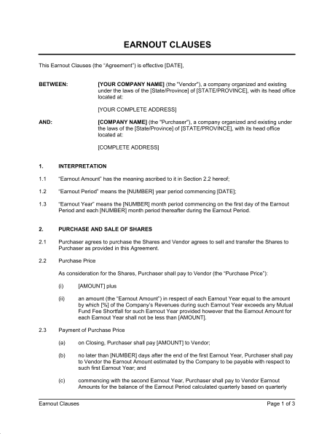
Earn outs
“Typically” used for fast growing companies and tied to revenue
Just secured new large contracts
Customer concentration
Can have an upside for the seller
Contingent upon reaching revenue goals
Are INELIGIBLE for SBA
Diamond Financial Services, Inc. Copyright 2020
Notes:
Earn outs are NOT eligible to be included in an SBA transaction– Here is the alternative that we utilize with our lenders
The downside is

Slide 11
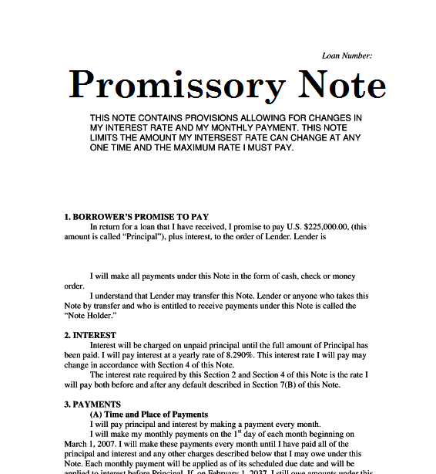
Forgivable promissory
note terms
“Typically” used for fast growing companies and tied to revenue
Milestones are determined by buyer and seller
No set level of note reduction
Cannot have an upside for the seller
Flexible terms with no lender involvement*
* Aside from cash flow calculations
Diamond Financial Services, Inc. Copyright 2020
Notes:
Not all lenders will accept these
They are eligible and are also used all the time

Slide 12
Forgivable promissory
note terms
Forgivable promissory notes CANNOT:
Be credited toward down payment
Be removed for BV calculations
Removed from the down payment calculation (by reducing the selling price)
Increase seller’s overall compensation
Diamond Financial Services, Inc. Copyright 2020
Notes:
Not all lenders will accept these
They are eligible and are also used all the time

Slide 13
Just ASK us
We have posted all PPP and EIDL loan information on our website www.EasySBA.com
For questions regarding actual SBA rules please email us:
AskDiamond@easysba.com
THIS IS A FREE SERVICE
No cost or obligation in any way
EasySBA.com
888.238.0952
Supporting the broker industry since 1996
Broker Financing Assistance ~ Complete Customer Service ~ Greater Financing Avenues
Diamond Financial Services, Inc. Copyright 2020
Notes:
Our overwhelming weekly questions surround –
is this Lender policy or SBA rule?

